Slide 1

[Samsung PRISM] End Review Report
AI/ML Based Network Device Software upgrade in SDN Controlled Network
Working Team Details [Name & Email ID] :
CSW23VIT
College Professor(s): Dr. P. PRAKASAM || prakasam.p@vit.ac.in
Students:
SAKSHI A. RAGHAVAN || sakshiraghavan.a2020@vitstudent.ac.in
JAYA SRI KRISHNA.S || jayasri.krishna2020@vitstudent.ac.in
JANARTHANAN.P.M || janarthanan.pm2020@vitstudent.ac.in
Department: ECE
Date: 5 Nov 2019

Slide 2

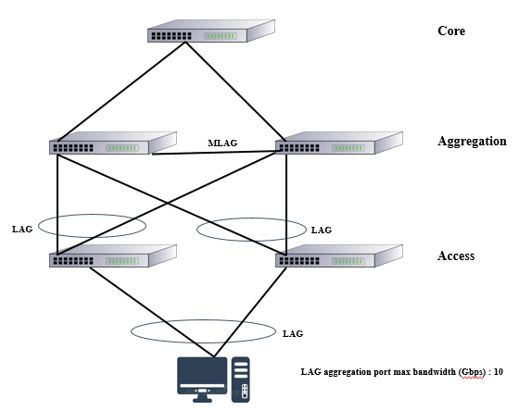
Information Retrieval | AI/ML Based Network Device Software upgrade in SDN Controlled Network
Problem Statement
The access layer provides network connectivity to end-user devices. It also provides high availability to end user traffic whereas the aggregation layer acts as a multiplexing point between the access layer
All traffic to and from the access layer flows through the aggregation layer, the aggregation layer need to provide high availability and resiliency in the campus network.
The software should be upgraded for all the devices in the campus network
Finding zero traffic window time as manually would be more challenging for network operator to upgrade software.
Expectations
Data set generation and pre-processing for the virtualized SDN network.
Training and testing of the AI model using the time-series models: SARIMA & Bi-LSTM
Predicting traffic through all the switches.
Prediction suitable ONOS s/w upgrade time for each switch.
Publishing a research paper.
Training/ Pre-requisites
Trained in Python libraries
Experience to work with
Data Structures
Databases
Algorithms
Student Learning
Software-defined network and mimicking the network virtually.
Traffic generation through each switch
Data pre-processing and parsing.
Training and testing of AI Model using SARIMA model and Bi-LSTM model.
Predicting suitable time window for software upgrade.
Writing a research paper
3
Members
Kick Off 31 OCT 22
DATA SET GENERATION AND PREPROCESSING
Milestone 1 31 DEC 22
DEVELOPING AI ENGINE USING BILSTM AND SARIMA FOR PREDICTION
Milestone 2 31 FEB 23
USE CASE DEVELOPMENT
RESEARCH PAPER - DRAFT
Closure 31st MAR 23
FINAL PAPER SUBMISSION TO JOURNAL
Notes:
-

Slide 3
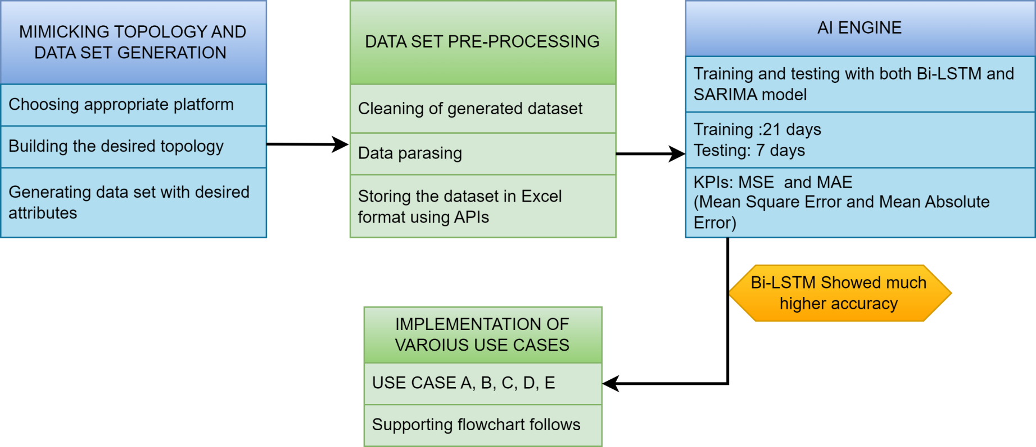
Approach / Solution
Concept Diagram :
( Complete workflow of the worklet)
Complete Workflow Of The Worklet

Slide 4
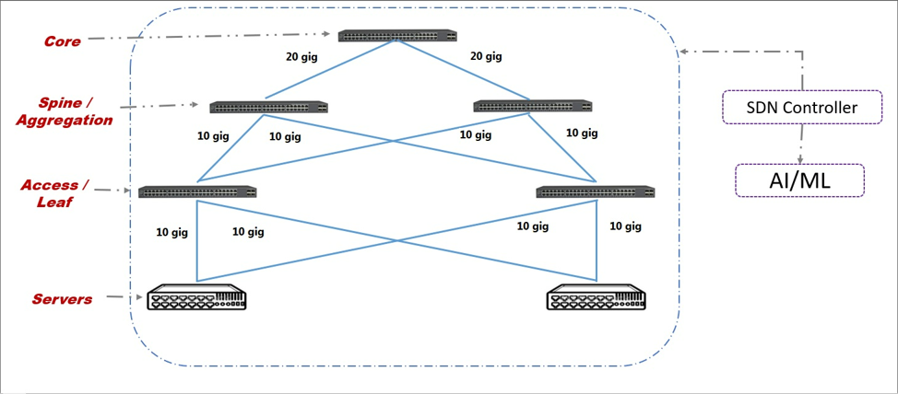
Approach / Solution
Concept Diagram :
( Topology Considered )

Slide 5
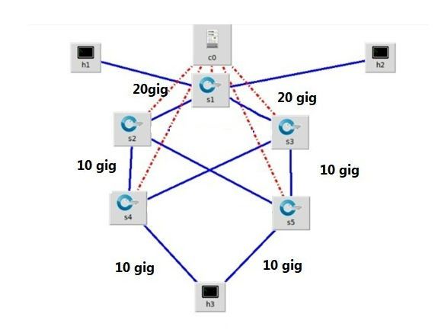
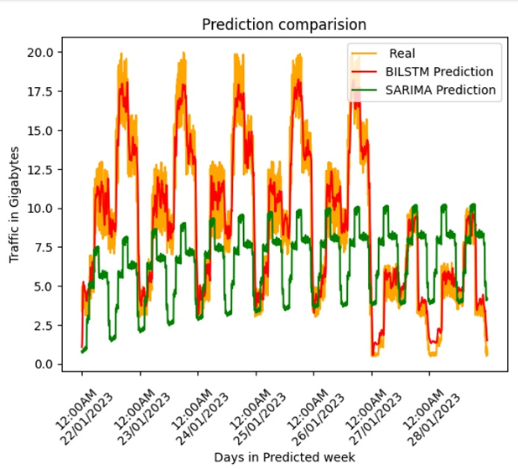
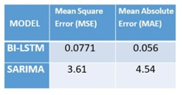
Approach / Solution
Concept Diagram :
( Mimicked Topology in Mininet || Prediction comparison with KPIs))
Mininet Topology
Prediction Comparison (Bi-LSTM Vs SARIMA model)
KPIs used for Prediction Comparison

Slide 6
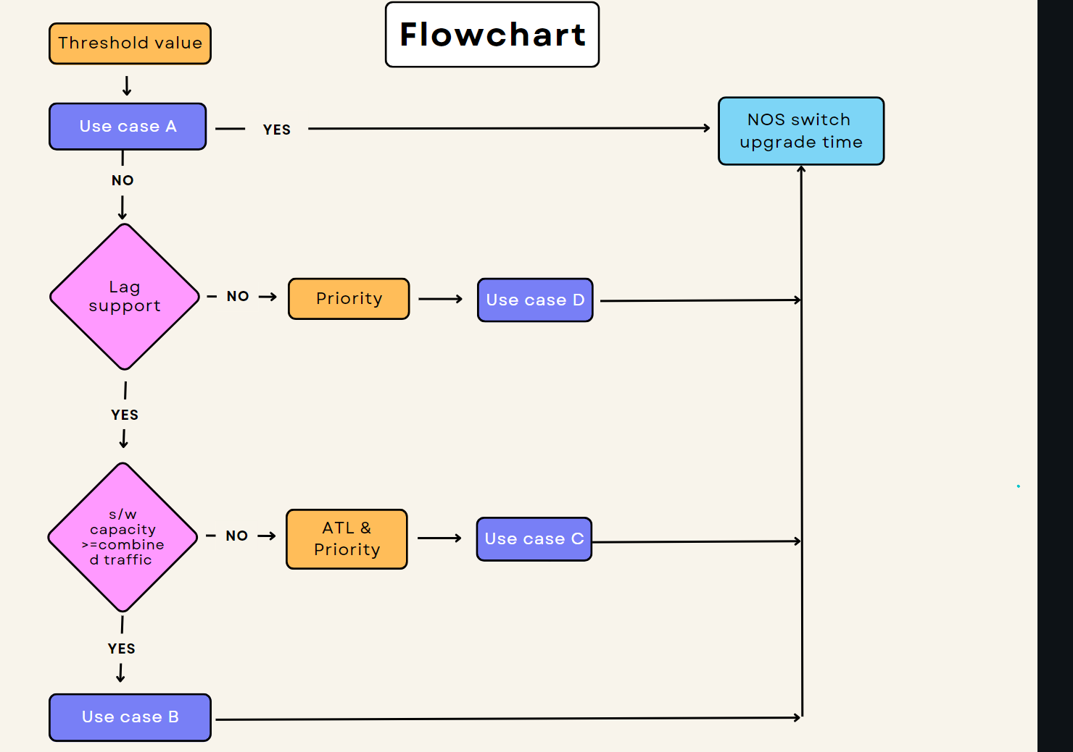
Approach / Solution
Concept Diagram :
( Algorithm Flowchart)
Algorithm Flowchart

Slide 7
Dataset(s) Analysis / Description
Dataset Capture / Preparation / Generation :
The dataset required to predict one week of data ought to contain features such as: IP address, Timestamp, Bandwidth of each switch in the topology and the connection priority.
Mininet library was employed to virtualize the intended topology network and ONOS controller was utilized to mimic the software-defined network.
Furthermore, mimicking of the data was achieved by pushing traffic into the Mininet with random bandwidths and duration with the real-world scenario.
The IP address was generated by random and the priority is assigned randomly according to their connection type.
Dataset Understanding / Analysis :
The Bandwidth for all the 5 switches for 28 days with a 5 minutes interval is dumped using Sflow. [All these data were included in a csv file for the use of AI model to predict the next 7 days of trend.]
With the use of Mininet, sFlow and ONOS controller we made the dataset consisting of data of 28 days.
To ensure that the model could detect the trend while predicting, it was made sure to vary the traffic on the weekends.
Dataset Pre-Processing / Related Challenges (if any) :
Choosing a suitable platform.
Identifying the suitable controller to mimic the SDN.
Data set generation to get the required features such as bandwidth and Timestamp. Reading the generated data in Excel format directly.

Slide 8
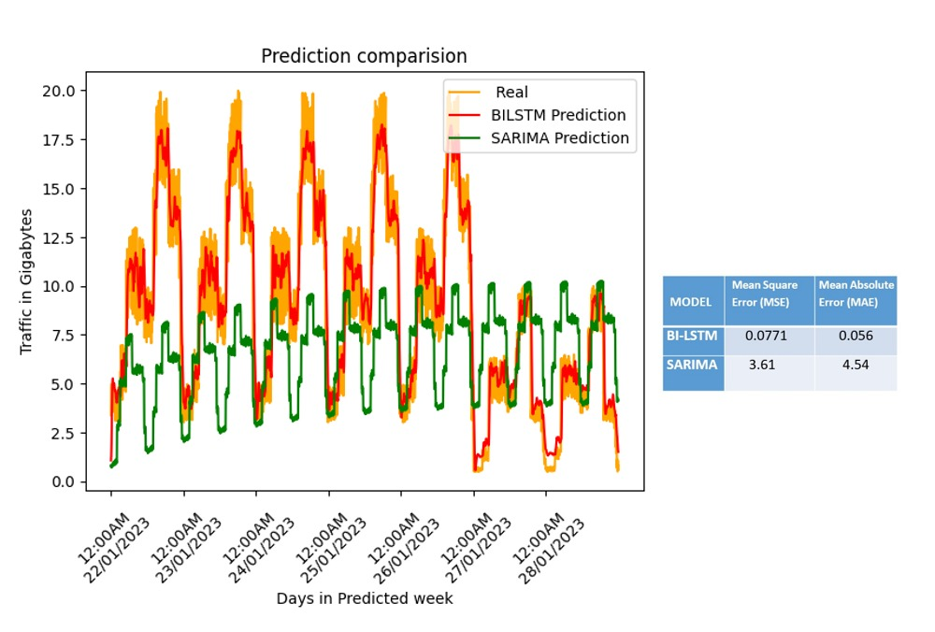
Experimental Results / Simulations / Observations
Results :
(Prediction Comparison (BiLSTM Vs SARIMA model)
Prediction Comparison (BiLSTM Vs SARIMA model)
It is evident that the BiLSTM was very close in predicting traffic to Real traffic whereas the graph of SARIMA shows huge variation from the Real traffic.
Hence, we have chosen BiLSTM time series prediction for our application over the conventional SARIMA model.

Slide 9
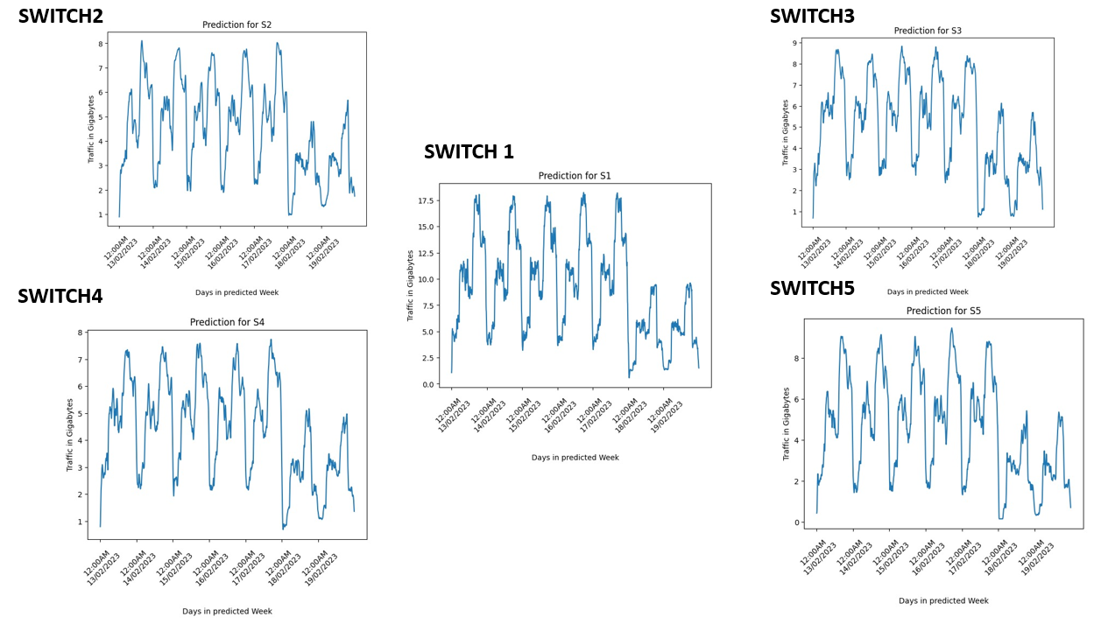
Experimental Results / Simulations / Observations
Results :
(Traffic Prediction for all devices in Topology)

Slide 10
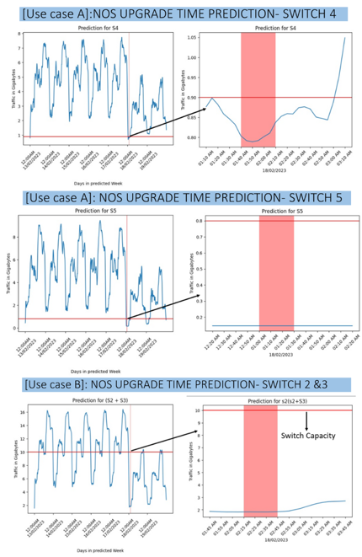
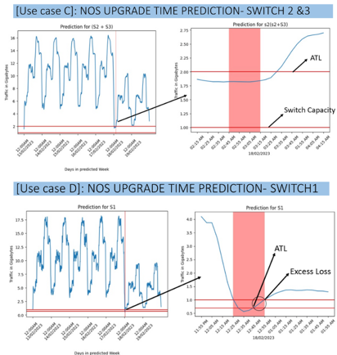
Experimental Results / Simulations / Observations
Results :
(Implementation of various Use Cases In Future Traffic Prediction To Identify Suitable Time Window For S/W Upgrade)

Slide 11
Experimental Results / Simulations / Observations
Results :
(Device Vs NOS suitable time)
SWITCH | TIME
S1 | 18/02/2023 @ 00:45 HOURS
S2 | 18/02/2023 @ 00:45 HOURS
S3 | 19/02/2023 @ 02:25 HOURS
S4 | 18/02/2023 @ 00:50 HOURS
S5 | 18/02/2023 @ 02:25 HOURS
The graphical result of all these use cases and their corresponding switches are recorded in the Figures and shown in previous slide.
As per the results of the prediction,
Switch S1 is likely to upgrade itself at 00:45 hours (12:45 a.m.) on the 18th of February 2023.
Switch S2 is also likely to upgrade itself at 00:45 hours (12:45 a.m.) on the 18th of February 2023, along with S1.
Switch S3 is likely to upgrade itself at 02:25 hours (02:25 a.m.) on the 19th of February 2023.
Switch S4 is likely to upgrade itself at 00:50 hours (12:50 a.m.) on the 18th of February 2023.
witch S5 is likely to upgrade itself at 02:25 hours (2:25 a.m.) on the 18th of February 2023.

Slide 12
Deliverable
Final Deliverables :
(Discuss in the form of bullets, what are the next steps to complete the solution, any road blocks / bottlenecks, any support needed from SRIB)
The final version of the research paper was submitted to the mentors
Fine tuning the paper based on the comments, if required.
Submitting the paper to the targeted Journal “IEEE Network”
IP / Paper Publication Plan :
(Details of papers / patentable ideas / innovative aspects that can lead to patentable ideas)
The final version of the research paper was submitted to the Samsung mentors
KPIs delivered/Expectations Met:
(Planned Expectations shared in Work-let vs Delivered Results)
Dataset generation completed
AI traffic analysis engine model trained and tested using both BiLSTM and SARIMA separately.
Traffic prediction done for each switch
Identified the lean traffic period as a suitable time window for software upgrade for each switch successfully
The final version of the research paper was submitted to the Samsung mentors

Slide 13
[ ALL DETAILS ON THIS SLIDE MANDATORY FOR WORK-LET CLOSURE AND CERTIFICATES]
Work-let Closure Details
Code Upload details:
Items | Details
KLOC (Number OF Lines of codes in 000’s)
Model and Algorithm details | BiLSTM and Sarimal models
Is Mid review, end review report uploaded on Git ? | Uploaded
Link for Git | https://github.ecodesamsung.com/SRIB-PRISM/VIT_CSW23VIT_AI_ML_based_Network_Device_Software_Upgrade_in_SDN_Controlled_Network
Data details (if applicable):
Items | Data folder 1 | Data folder 2 | Data Folder 3……..
Name & Type of Data (Audio/Image/Video) | All Diagrams (Image) | All ppts for review meetings(PPT)
Number of data points | 3 | 9
Source of Data (self collected, Scrapped, available on open source) | Self Collected | Self Collected
Google drive link/ git link to access data | https://github.ecodesamsung.com/SRIB-PRISM/VIT_CSW23VIT_AI_ML_based_Network_Device_Software_Upgrade_in_SDN_Controlled_Network/tree/main/Documents
Note: If data uploaded on google drive, access to be shared to prism.srib@gmail.com

Slide 14
Thank you

